Slide 1
Website Report – 2018/2019 GLOBE Country Coordinator Admin Review
Cornell Lewis
Science Systems and Applications, Inc.

Slide 2
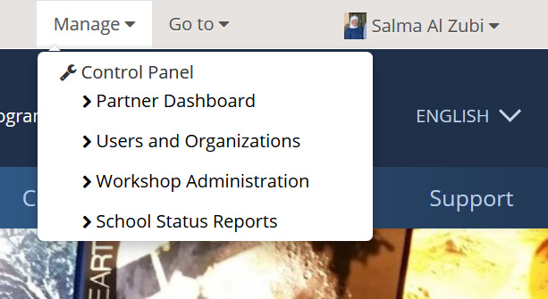
Top Navigation Admin Controls (after logging-in)
Manage Menu – where you go to manage users, organizations and workshops

Slide 3
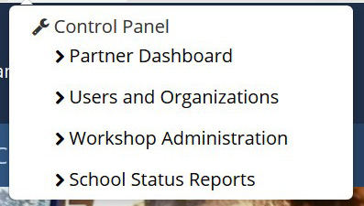
Top Navigation Admin Controls
Partner Dashboard
Quick way to see what teachers are doing in your country.
Status summary of workshops in your country
Users and Organizations
See and manage all schools and users under your country

Slide 4
Top Navigation Admin Controls
Workshop Tool
Used to create and manage workshops.
Make sure to mark users as “Complete” under View Roster!
All new trainers have been added to your country’s Trainer Organization.
School Status Report
Obtain school metrics and see which schools are reporting the most or no data.

Slide 5
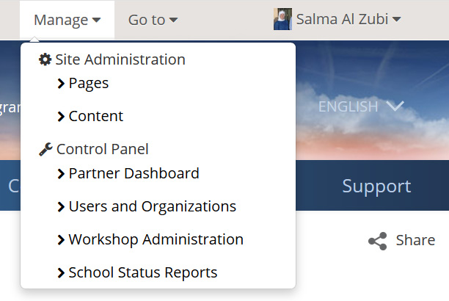
Top Navigation Admin Controls
Manage Menu – Only when on your country page, you’ll also see - Site Administration: Pages, Content

Slide 6
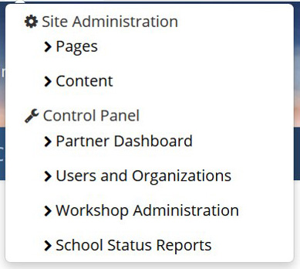
Top Navigation Admin Controls
Pages
Add new pages to your country page
Content
Create News and Events about your country org. You can request they are distributed up to your region and the main GLOBE section

Slide 7
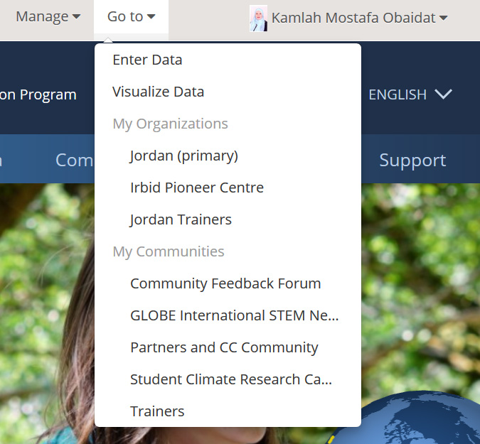
Top Navigation Admin Controls
Go to Menu – quick links to your orgs and communities
Enter Data – Go to Data Entry page
Visualize Data – Go to Visualization System
My Organizations
Your country and other organizations you are associated with
My Communities
Communities you are a member of where you can post on forums

Slide 8
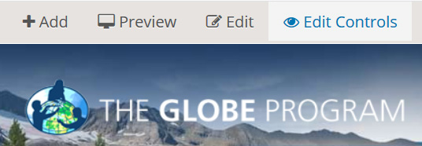
Top Navigation Admin Controls
Edit Controls – you’ll see this when on pages where you can edit the content:
About & Contacts
Resources
Clicking this
Turns on this

Slide 9
Top Navigation Admin Controls
Your Name – where you go to manager your information

Slide 10
Top Navigation Admin Controls
My Page
Add some information about yourself, add your picture.
Create a blog
Collaborate with your friends
Click on your name at the top right > My Page.
My Account
Make sure you are identified as a CC, assistant CC or trainer and you are associated with the correct organization(s).
Update your phone number, picture, email address and other contact info.
Set your country as your primary organization

Slide 11
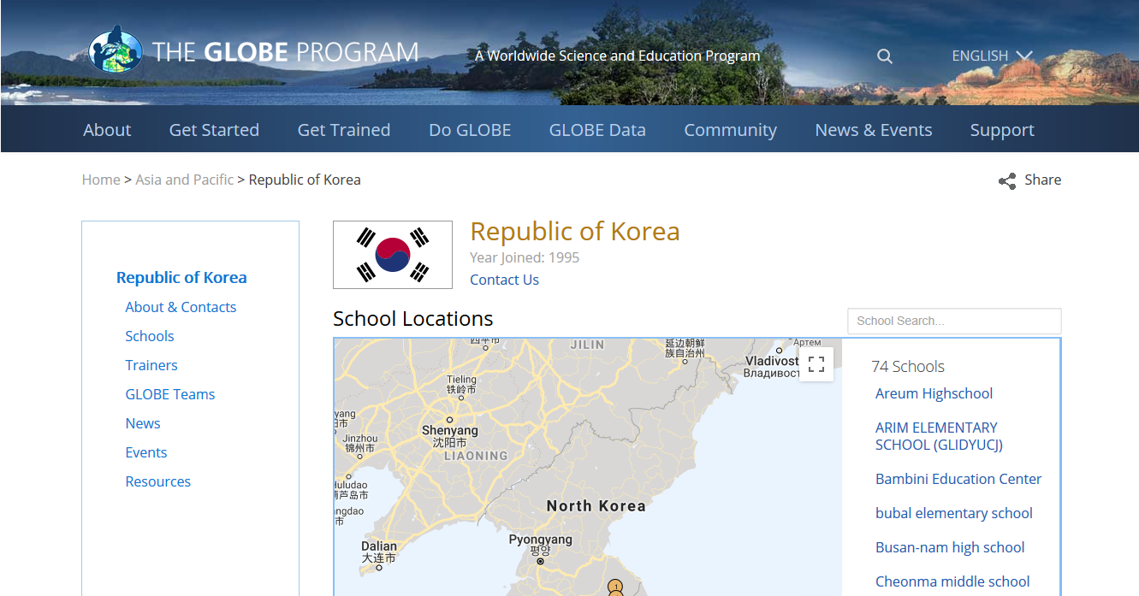
Your Country Page

Slide 12
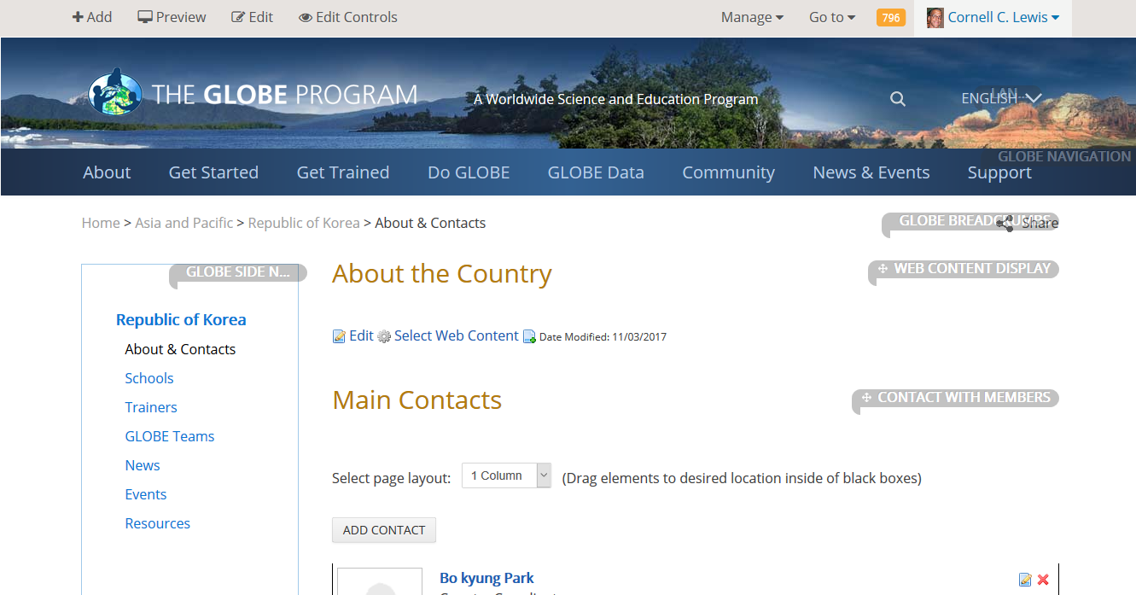
Your Country Page – About & Contacts

Slide 13
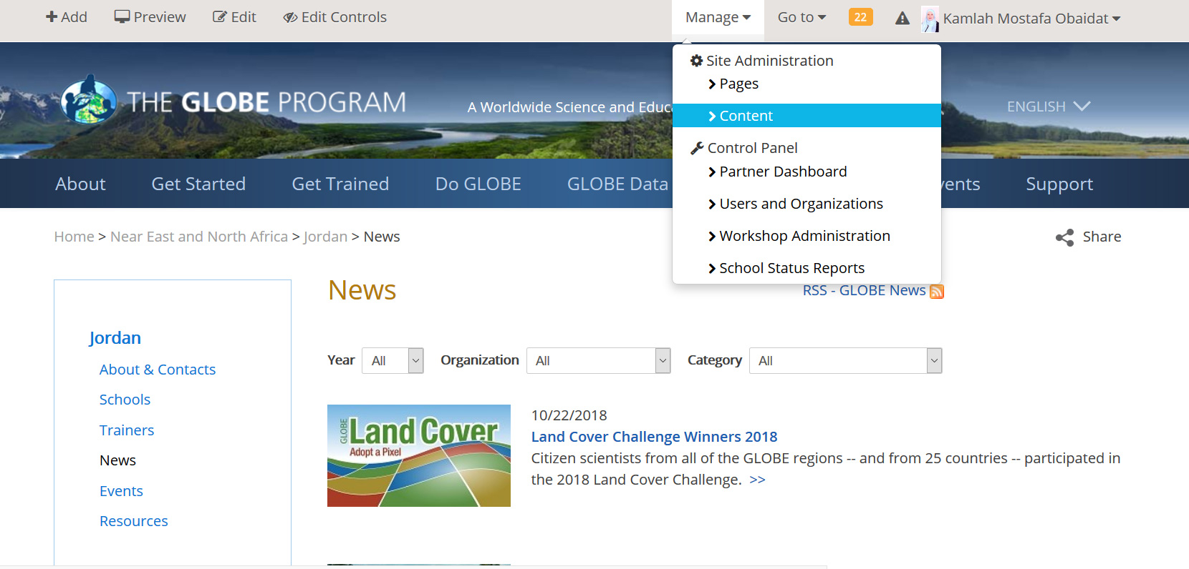
Your Country Page – News (& Events)

Slide 14
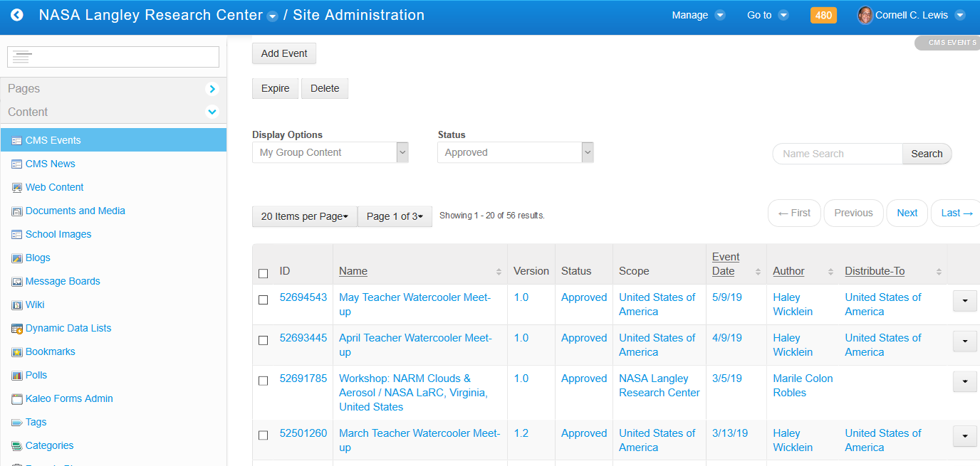
Your Country Page – News (& Events)

Slide 15
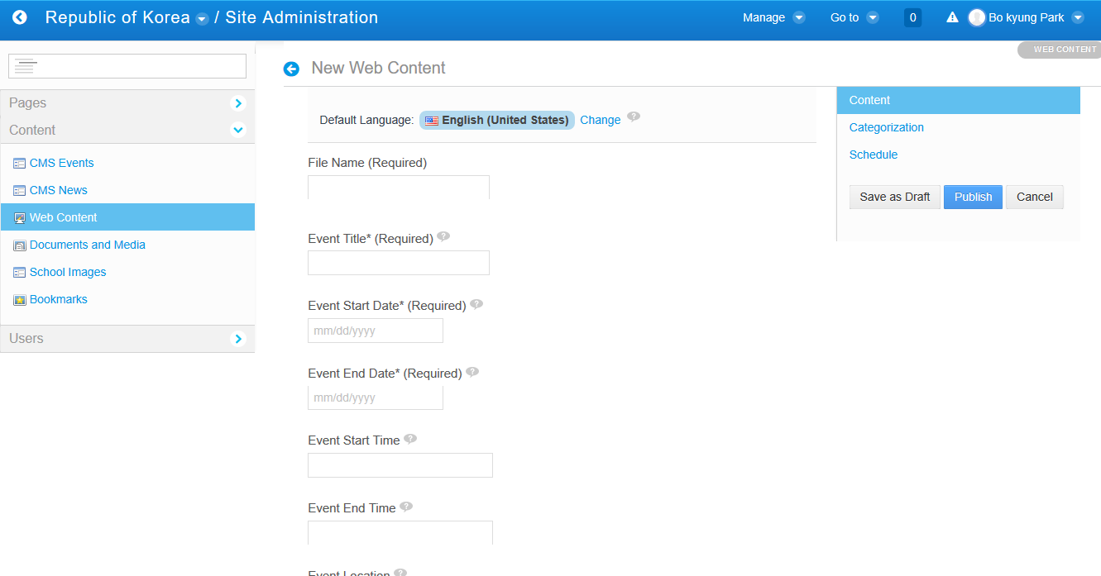
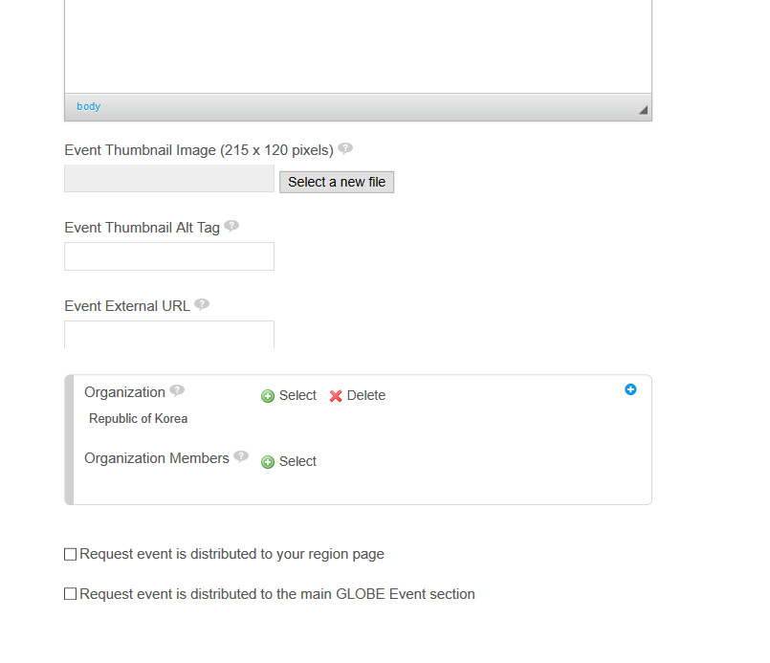
Your Country Page – News (& Events)

Slide 16
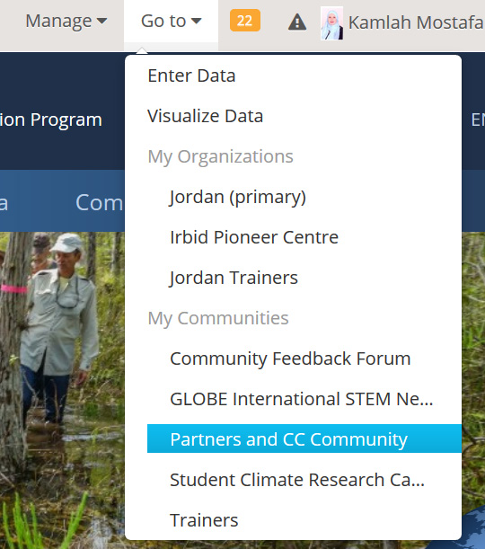
Resources
Partner and Country Coordinator Community
Resources for GLOBE partners
Tutorials on how to manage your country page, schools, users, workshops, and metrics are here

Slide 17
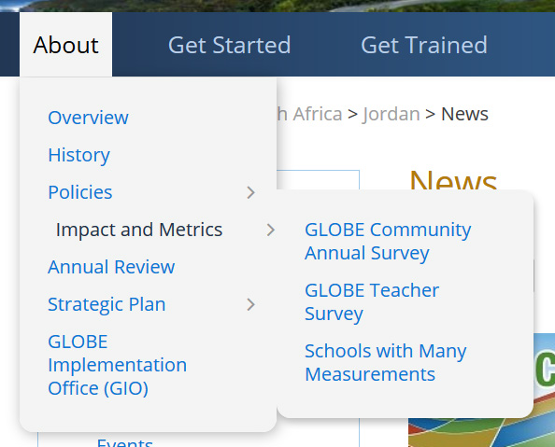
Resources
Country Metrics
Your country metrics are available at: About/Impact and Metrics

Slide 18
Resources
Tutorials link for partner and CCs: https://www.globe.gov/group/partners/overview/partner-and-cc-website-tutorials

Slide 19
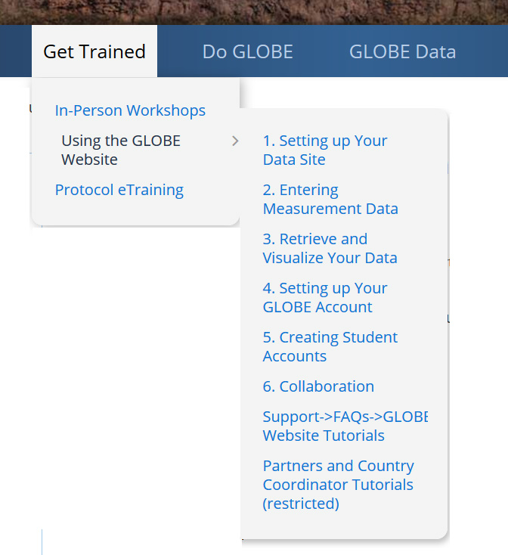
Resources
Website tutorials for teachers
Tutorials on how to create data sites, enter measurements, create student accounts.

Slide 20
GLOBE Observers vs GLOBE Members (Teachers)
GLOBE Observers
Signs-up for an account through the GLOBE Observer app (or website).
Untrained users who are able to enter GLOBE observations (clouds, mosquito habitat mapper and Land cover) through the app.
A GLOBE Observer can enter measurements for other protocols by becoming eTrained but still have limited capabilities on the website.
They do not have a My Page, cannot post to forums, and are not visible or identified on the website (their name isn’t listed or searchable).
The GLOBE Observer was created to allow the public (non-GLOBE teachers) to become involved as a ‘Citizen Scientist’.
You can see the total number of GLOBE Observers in your partner organization on your Partner Dashboard.
GLOBE Observers can take an in-person workshop to become GLOBE Members.
GLOBE Observers can be searched by name and email in the workshop admin tool

Slide 21
GLOBE Observers vs GLOBE Members (Teachers)
GLOBE Members (Teachers)
Users who request a GLOBE teacher account that are approved by the help-desk and can become a Trained GLOBE Member by one of these methods:
Takes a GLOBE workshop
Passes the required Protocol e-training assessments (Intro to GLOBE, Intro to a Sphere + 1 protocol)
GLOBE Members have a ‘My Page’, can collaborate with other community members, can post on forums, create blogs, submit student reports, use student accounts and can get recognized through GLOBE certificate and award programs (coming soon).

Slide 22
Key Tips to Remember - Summary
All your management information is under “Manage”
Your GLOBE information is on your “My Page” – collaboration, blog and contact
Go to your country page to publish news/events (Manage)
All of your organizations and communities you are associated with are under “Go To”
Teachers can create student accounts (My Page).
Teacher and Student accounts can be used with GLOBE Observer and GLOBE Data Entry apps to enter data for their school
Go the Workshop Admin tool under “Manage” to create workshops and add teachers to the roster (Trainers can now do this too)
Use the partner dashboard to see what teachers are doing in your country.

Slide 23
Your Feedback is Important
What improvements would you like to see on the website?
How can we improve the site for teachers?
What can be done to make the site easier to ‘Do GLOBE’ as a Country Coordinator?
Contact me at cornell.lewis@ssaihq.com

Slide 24
Your Country Page – About & Contacts
Four things to do today:
Upload your profile photo
Say something about yourself on your My Page
Select your contacts
Say something about your country

Slide 25
Thank You

